Slide 1
Network+ Guide to Networks Eighth Edition
Chapter 5
Network Cabling
© 2019 Cengage. All Rights Reserved. May not be copied, scanned, or duplicated, in whole or in part, except for use as permitted in a license distributed with a certain product or service or otherwise on a password-protected website for classroom use.

Slide 2
Objectives
5.1 Explain basic data transmission concepts, including throughput, bandwidth, multiplexing, and common transmission flaws
5.2 Identify and describe the physical characteristics and official standards of coaxial cable, twisted-pair, and fiber-optic cable, and their related connectors
5.3 Compare the benefits and limitations of various networking media
5.4 Select and use the appropriate tool to troubleshoot common cable problems

Slide 3
Transmission Basics
Transmission techniques in use on today’s network are complex and varied
This section covers:
Measurements that indicate network efficiency
Obstacles to good network performance

Slide 4
Throughput and Bandwidth (1 of 2)
Bandwidth
The amount of data that could be theoretically transmitted during a given period of time
Throughput
Measure of how much data is actually transmitted during given time period
Both are commonly expressed as bits transmitted per second, called bit rate

Slide 5
Throughput and Bandwidth (2 of 2)
Table 5-1 Throughput and bandwidth measures
Quantity | Prefix | Abbreviation
1 bit per second | n/a | 1 bps = 1 bit per second
1000 bits per second | kilo | 1 Kbps = 1 kilobit per second
1,000,000 bits per second | mega | 1Mbps = 1 megabit per second
1,000,000,000 bits per second | giga | 1 Gbps = 1 gigabit per second
1,000,000,000,000 bits per second | tera | 1 Tbps = 1 terabit per second

Slide 6
Transmission Flaws (1 of 4)
Noise:
Any undesirable influence degrading or distorting signal
Measured in d B (decibels)
Types of noise
E M I (electromagnetic interference):
Caused by motors, power lines, televisions, copiers, fluorescent lights, etc.
One type of E M I is R F I (radio frequency interference)
Cross-talk:
Signal on one wire infringes on adjacent wire signal
Alien cross-talk occurs between two cables
Near end cross-talk (NEXT) occurs near source
Far end cross-talk (FEXT) occurs at the far end

Slide 7
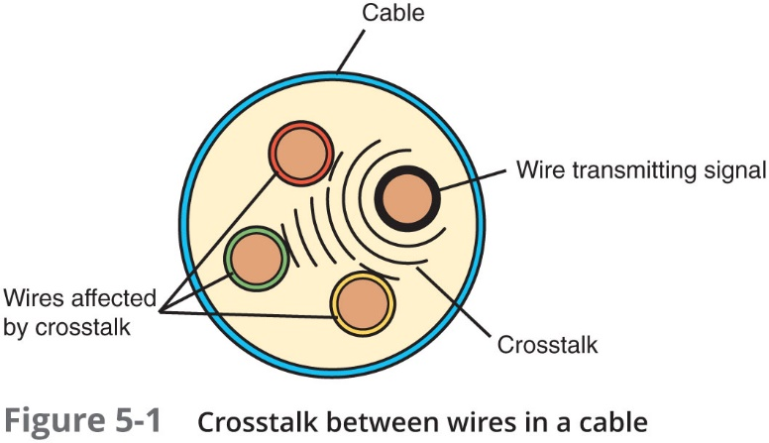
Transmission Flaws (2 of 4)

Slide 8
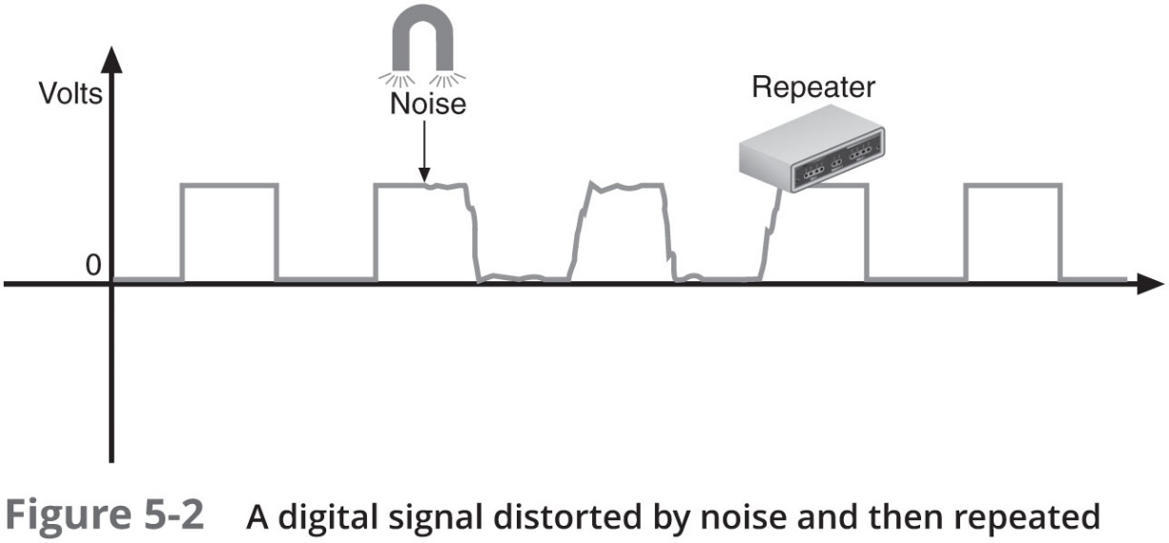
Transmission Flaws (3 of 4)
Attenuation
Loss of signal’s strength as it travels away from source
Signals can be boosted:
Repeater—Regenerates a digital signal in its original form
Without noise previously accumulated

Slide 9
Transmission Flaws (4 of 4)
Latency:
Delay between signal transmission and receipt
May cause network transmission errors
Latency causes:
Cable length
Intervening connectivity device
Round trip time (R T T):
Time for packet to go from sender to receiver, then back from receiver to sender
If packets experience varying amounts of delay:
They can arrive out of order
A problem commonly called jitter or P D V (packet delay variation)

Slide 10
Duplex, Half-Duplex, and Simplex (1 of 2)
N I C settings include the direction in which signals travel over the media and the number of signals that can traverse the media at any given time
These two settings are combined to create different methods of communication
Full-duplex—Also called duplex
Signals travel in both directions over a medium simultaneously
Half-duplex
Signals may travel in both directions but only in one direction at a time
Simplex
Signals may travel in only one direction and is sometimes called one-way or unidirectional, communication

Slide 11
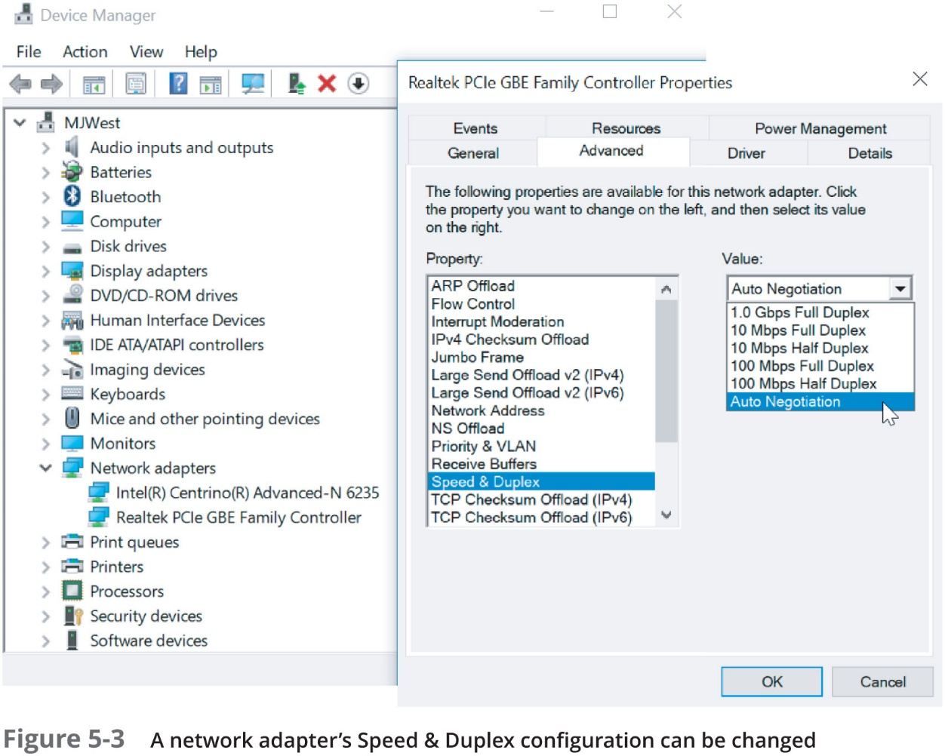
Duplex, Half-Duplex, and Simplex (2 of 2)

Slide 12
Multiplexing (1 of 4)
Multiplexing
A form of transmission that allows multiple signals to travel simultaneously over one medium
Subchannels
Logical multiple smaller channels
Multiplexer (mux):
Combines many channel signals
Required at the transmitting end of the channel
Demultiplexer (demux)
Separates the combined signals

Slide 13
Multiplexing (2 of 4)
Three types of multiplexing are used on copper lines
T D M (time division multiplexing)
Divides channel into multiple time intervals
S T D M (statistical time division multiplexing):
Transmitter assigns slots to nodes
According to priority and need
Maximizes available bandwidth on a network
F D M (frequency division multiplexing)
Assigns different frequency band for each communications subchannel

Slide 14
Multiplexing (3 of 4)
Three types of multiplexing are used on fiber-optic cable
W D M (wavelength division multiplexing)
Carries multiple light signals simultaneously by dividing a light beam into different wavelengths or colors
D W D M (dense wavelength division multiplexing):
Extraordinary capacity
Typically used on high-bandwidth or long-distance WAN links
C W D M (Coarse wavelength division multiplexing):
Channels are spaced more widely apart across entire frequency band
Effective distance is more limited because the signal is not amplified

Slide 15
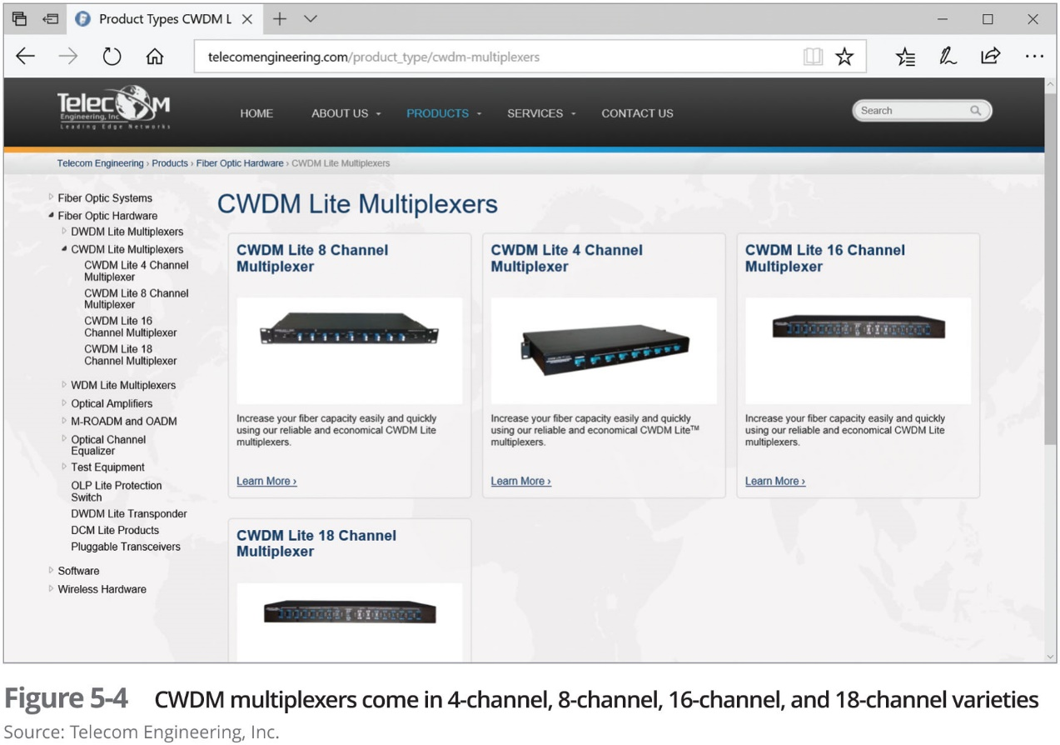
Multiplexing (4 of 4)

Slide 16
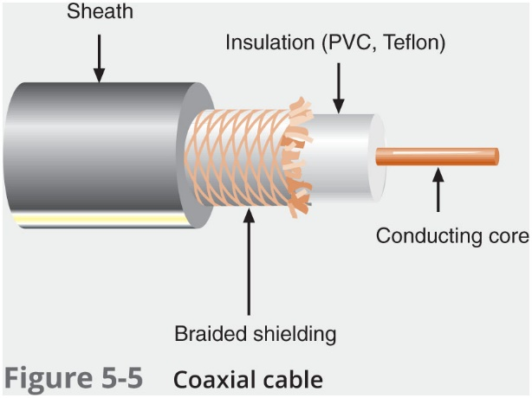
Copper Cable
Coaxial cable is considered a “legacy” cable

Slide 17
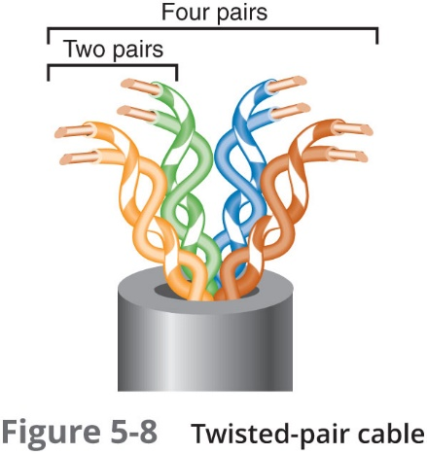
Twisted-Pair Cable (1 of 3)
Color-coded insulated copper wire pairs:
0.4–0.8 mm diameter
Encased in a plastic sheath
Every two wires are twisted together

Slide 18
Twisted-Pair Cable (2 of 3)
Twisted-pair cabling in Ethernet networks contains four wire pairs:
Fast Ethernet uses one pair to send data and one pair to receive data
Networks using Gigabit Ethernet use all four pairs for both sending and receiving
Wiring standard specification
T I A/E I A 568
Most common twisted pair types:
Category (cat) 3, 5, 5e, 6, 6a, and 7
CAT 5e or higher used in modern LANs
Two categories:
Shielded twisted pair (S T P)
Unshielded twisted pair (U T P)

Slide 19
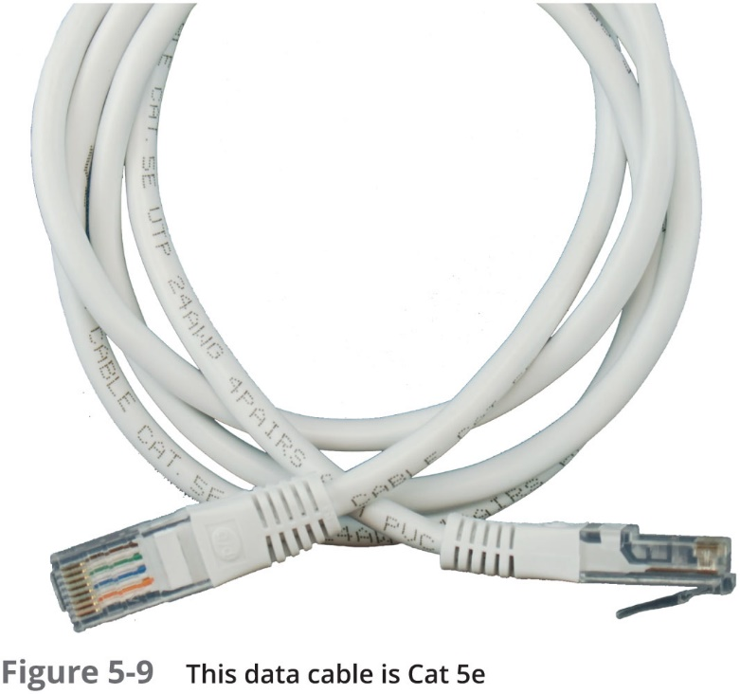
Twisted-Pair Cable (3 of 3)

Slide 20
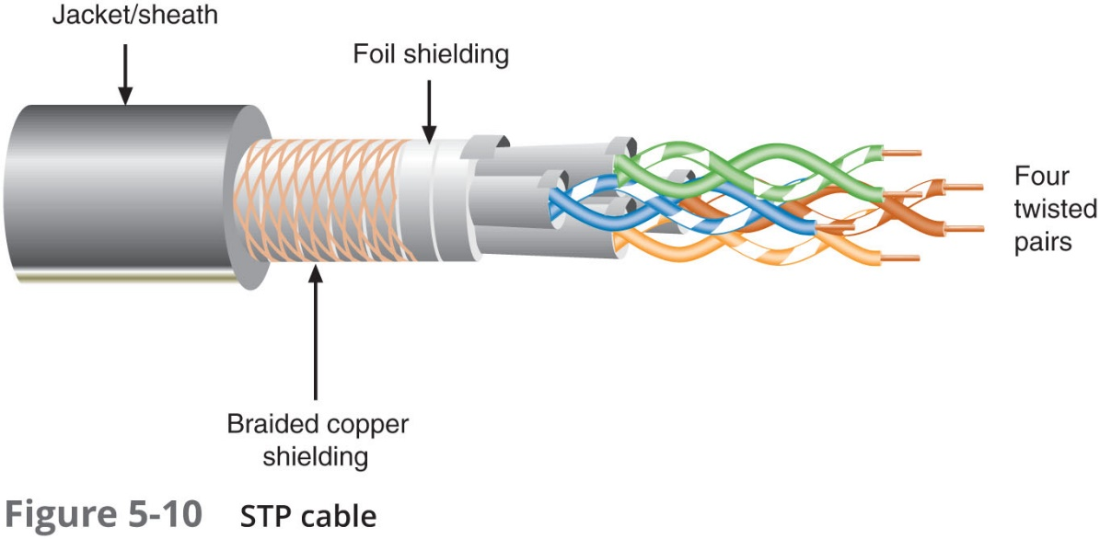
S T P (Shielded Twisted Pair)
Individually insulated
Surrounded by metallic substance shielding (foil):
Barrier to external electromagnetic forces
Contains electrical energy of signals inside
Must be grounded

Slide 21
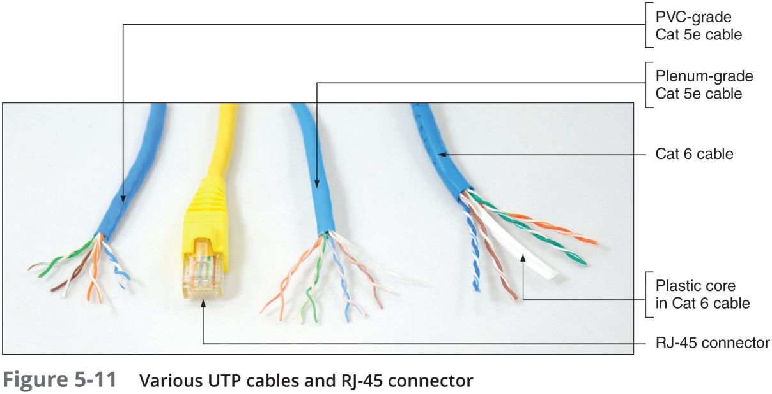
U T P (Unshielded Twisted Pair)
One or more insulated wire pairs encased in plastic sheath:
No additional shielding
Less expensive, less noise resistance

Slide 22
Comparing S T P and U T P
Throughput
S T P and U T P can transmit the same rates
Cost
S T P and U T P vary in cost
S T P is more expensive than U T P
Connector
S T P and U T P use Registered Jack 45
Noise immunity
S T P is more noise resistant
Size and scalability
Maximum segment length for both: 100 meters on Ethernet networks that support data rates from 1 Mbps and 10 Gbps

Slide 23
Cable Pinouts (1 of 4)
Proper cable termination is a requirement for two nodes on a network to communicate
Poor terminations can lead to loss or noise in a signal
T I A/E I A specifies two methods of inserting wires into RJ-45 plugs:
T I A/E I A 568A
T I A/E I A 568B
No functional difference between the two standards
Just make sure you use the same standard on every RJ-45 plug and jack

Slide 24
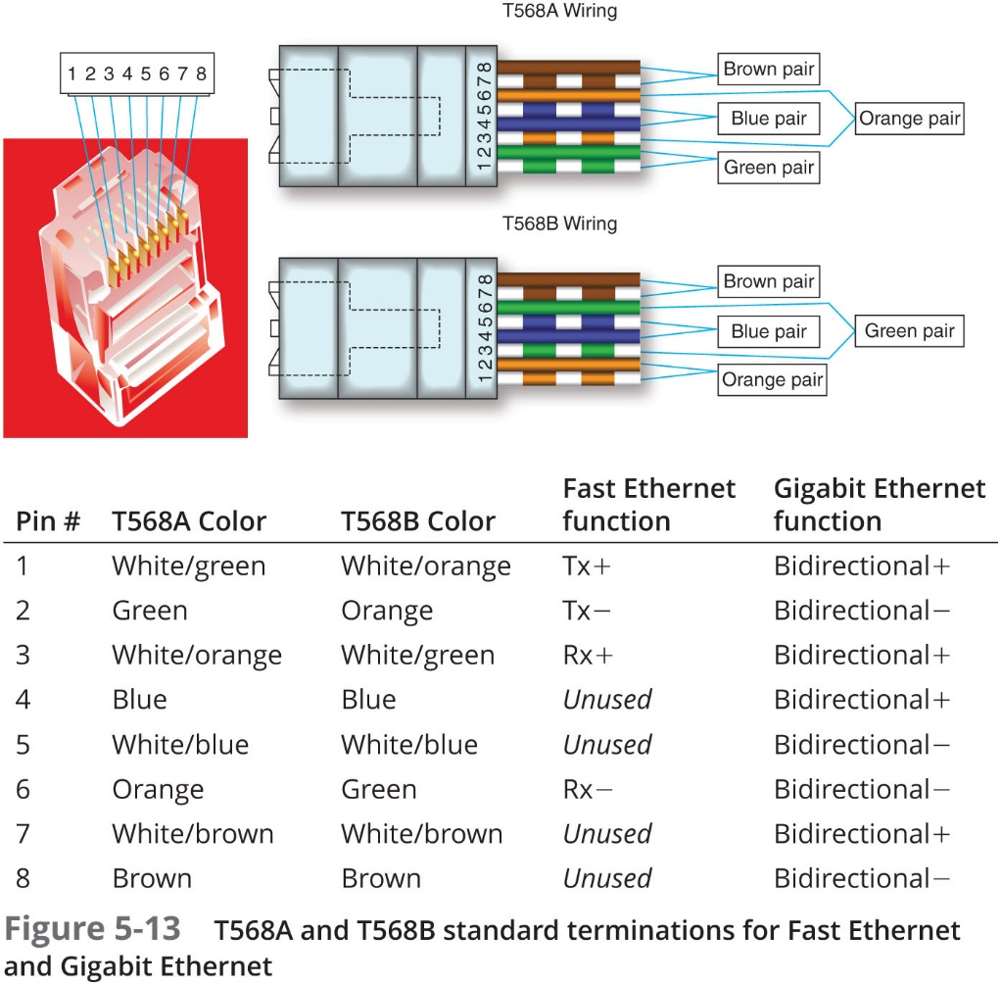
Cable Pinouts (2 of 4)

Slide 25
Cable Pinouts (3 of 4)
Straight-through cable (also called patch cable)
Terminate RJ-45 plugs at both ends identically
Crossover cable
Transmit and receive wires on one end reversed
Rollover cable (also called console cable):
All wires are reversed
Terminations are a mirror image of each other
Used to connect a computer to the console port of a router
When making configuration changes to the device

Slide 26
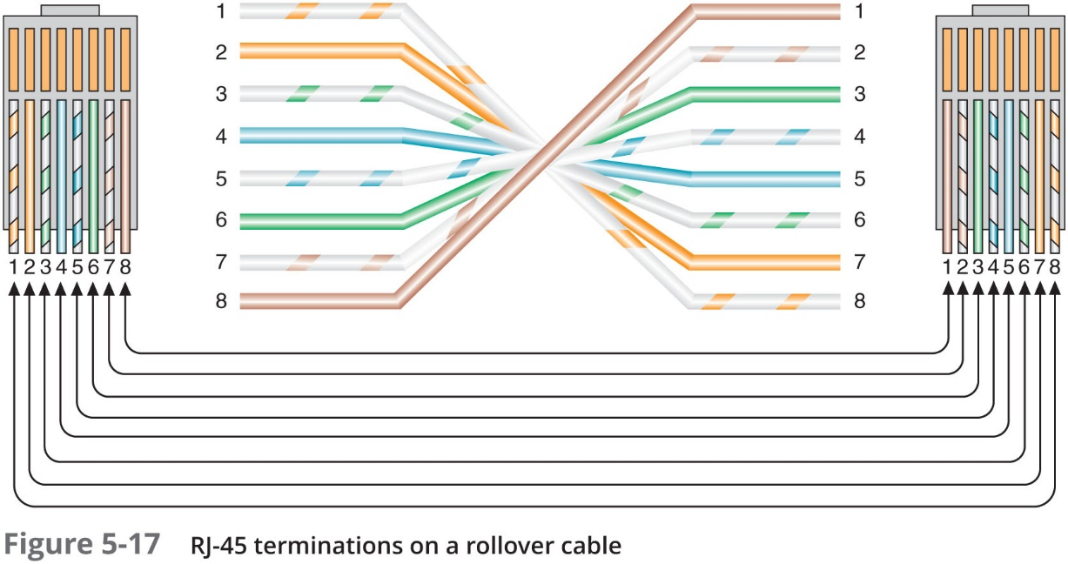
Cable Pinouts (4 of 4)

Slide 27
P o E (Power over Ethernet) (1 of 4)
P o E—I E E E 802.3af standard which specifies a method for supplying electrical power over twisted-pair Ethernet connections
Amount of power provided:
15.4 watts for standard Po E devices
25.5 watts for newer P o E+ devices (802.3at standard)
P o E standard specifies two types of devices:
P S E (power sourcing equipment)
P D (powered devices)

Slide 28
P o E (Power over Ethernet) (2 of 4)
P o E requires Cat 5 or better copper cable
The I E E E standard requires that a P S E device first determine whether a node is P o E-capable before attempting to supply it with power
On networks that demand P o E but don’t have P o E-capable equipment, you can add P o E adapters

Slide 29
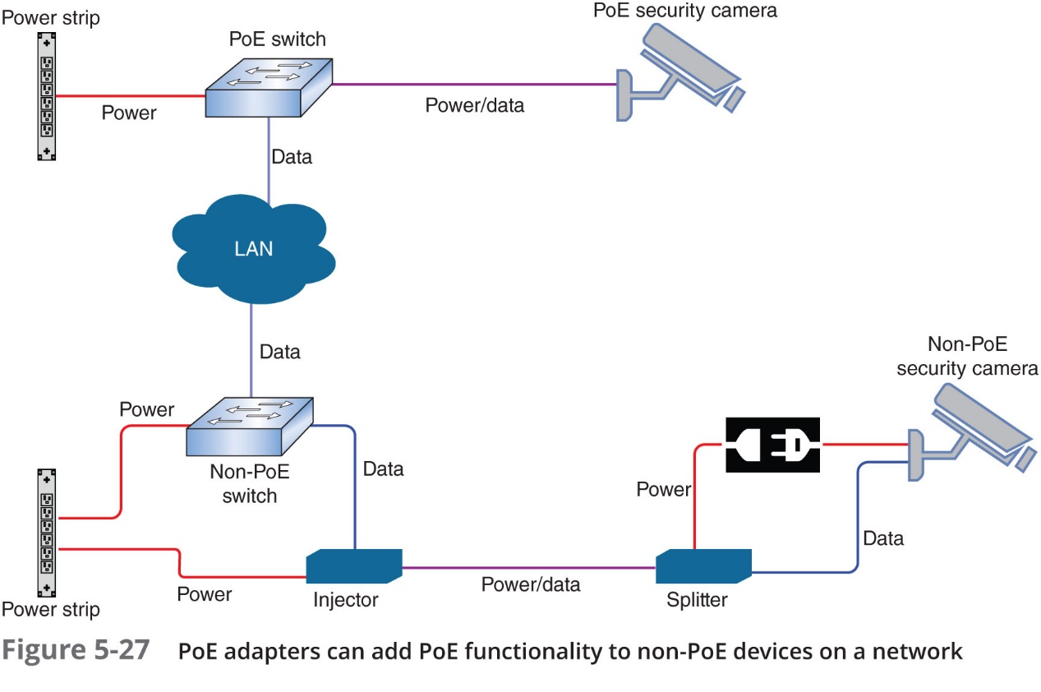
P o E (Power over Ethernet) (3 of 4)

Slide 30
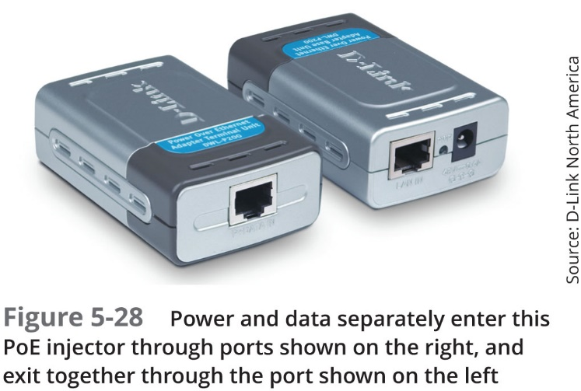
P o E (Power over Ethernet) (4 of 4)

Slide 31
Ethernet Standards for Twisted-Pair Cable (1 of 2)
A cable’s category (Cat 5e or Cat 6) determines the fastest network speed it can support
A Layer 1 characteristic
A device’s N I C is also rated for maximum network speeds
Most LANs today use devices and N I Cs that can support Fast Ethernet and Gigabit Ethernet
Devices can auto-negotiate for the fastest standard they have in common

Slide 32
Ethernet Standards for Twisted-Pair Cable (2 of 2)
Table 5-4 Ethernet standards used with twisted-pair cabling
Standard | Maximum transmission speed (Mbps) | Maximum distance per segment (m) | Physical media | Pairs of wires used for transmission
100Base-T Fast Ethernet | 100 | 100 | Cat 5 or better | 2 pair
1000Base-T Gigabit Ethernet | 1000 | 100 | Cat 5 or better (Cat 5e is preferred) | 4 pair
10GBase-T 10-Gigabit Ethernet | 10,000 | 100 | Cat 6a or Cat 7 (Cat 7 is preferred) | 4 pair

Slide 33
Fiber-Optic Cable (1 of 4)
Fiber-optic cable (fiber)
Contains one or more glass or plastic fibers at its center (core)
Data transmission
Pulsing light sent from laser or light-emitting diode (L E D) through central fibers
Cladding:
Layer of glass or plastic surrounding fibers
Different density from glass or plastic in strands
Reflects light back to core
Allows fiber to bend

Slide 34
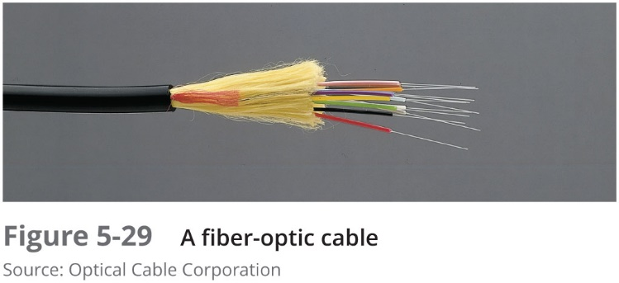
Fiber-Optic Cable (2 of 4)
Plastic buffer outside cladding:
Protects cladding and core
Opaque to absorb escaping light
Surrounded by Kevlar (polymeric fiber) strands
Plastic sheath covers Kevlar strands

Slide 35
Fiber-Optic Cable (3 of 4)
Benefits over copper cabling:
Extremely high throughput
Very high noise resistance
Excellent security
Able to carry signals for longer distances
Drawbacks:
More expensive than twisted pair cable
Requires special equipment to splice

Slide 36
Fiber-Optic Cable (4 of 4)
Throughput
Proven reliable in transmitting data at rates that can reach 100 gigabits per second per channel
Cost
Most expensive transmission medium
Noise immunity
Unaffected by E M I
Size and scalability:
Segment lengths vary from 2 to 40,000 meters
Depends on the light’s wavelength and type of cable

Slide 37
S M F (Single Mode Fiber) (1 of 2)
Consists of narrow core (8–10 microns in diameter):
Laser-generated light travels over one path
Little reflection
Light does not disperse as signal travels
Can carry signals many miles:
Before repeating is required
Rarely used for shorter connections:
Due to cost
The Internet backbone depends on S M F

Slide 38
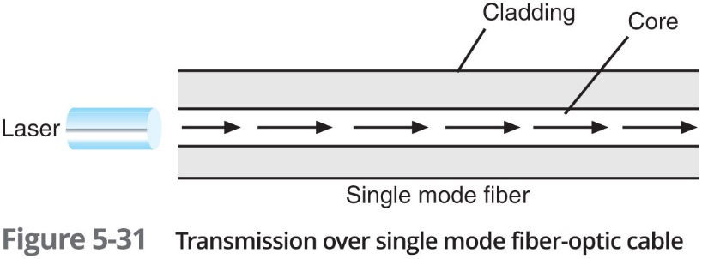
S M F (Single Mode Fiber) (2 of 2)

Slide 39
M M F (Multimode Fiber) (1 of 2)
Contains a core with a larger diameter than single mode fiber
Common sizes: 50 or 62.5 microns
Laser or L E D generated light pulses travel at different angles
Greater attenuation than single-mode fiber
Common uses:
Cables connecting routers, switches, and servers on the backbone of a network
Cables to connect a desktop workstation to the network
Transition between S M F and M M F might occur at an F D P (fiber distribution panel)

Slide 40
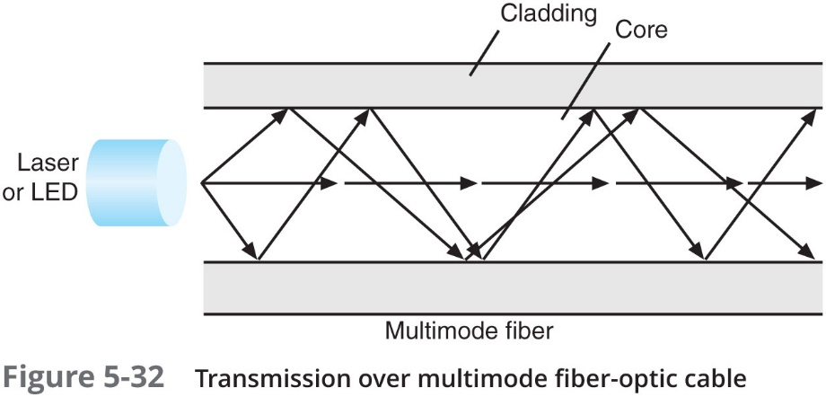
M M F (Multimode Fiber) (2 of 2)

Slide 41
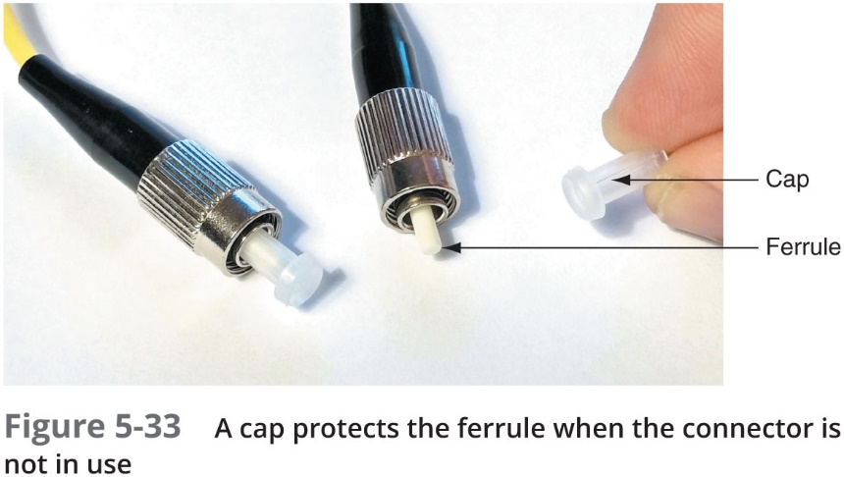
Fiber Connectors (1 of 3)
M M F connectors
Classified by the number of fibers
S M F connectors
Classified by size and shape of the ferrule
Ferrule—The extended tip of a connector that makes contact with the receptacle in the jack

Slide 42
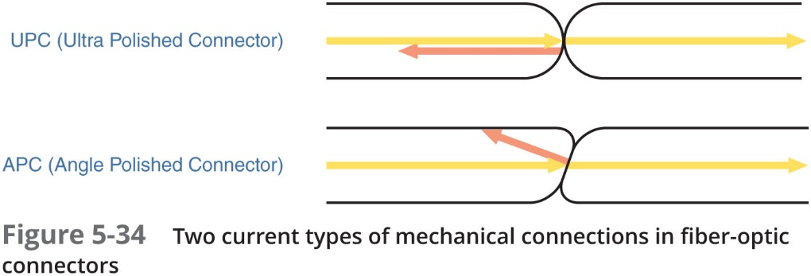
Fiber Connectors (2 of 3)
Shapes and polishes used by S M F ferrules to reduce back reflection:
Ultra Polished Connector (U P C)
Angle Polished Connector (A P C)

Slide 43
Fiber Connectors (3 of 3)
S M F connectors are typically available with a 1.25-mm ferrule or a 2.5-mm ferrule:
Most common 1.25-mm connector is the L C (local connector)
Two 2.5-mm connectors are the S C (standard connector) and ST (straight tip)
Most common M M F connector is the M T R J
Existing fiber networks might use S T or S C connectors
L C and M T-R J are used on the very latest fiber-optic technology

Slide 44
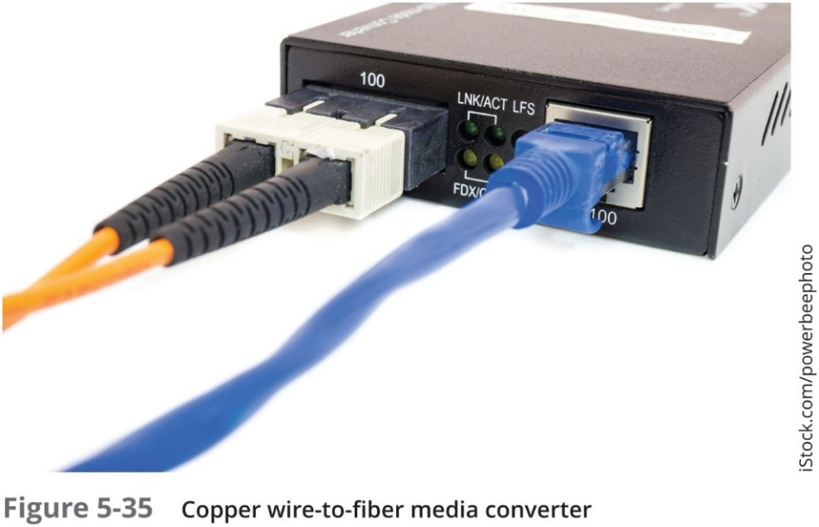
Media Converters
Media converter:
Hardware that enables networks or segments running on different media to interconnect and exchange signals
Completes the physical connection and converts electrical signals from copper cable to light wave signals
Can also be used to convert networks using M M F with networks using S M F

Slide 45
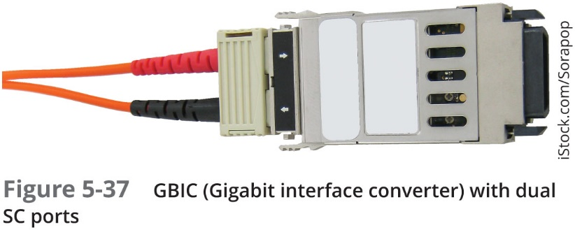
Fiber Transceivers (1 of 4)
Some switches allow you to change and upgrade its interfaces
They contain sockets where one of many types of modular interfaces, called transceivers, can be plugged in
G B I C—A standard type of modular interface designed for Gigabit Ethernet connections
May contain RJ-45 or fiber-optic cable ports

Slide 46
Fiber Transceivers (2 of 4)
Newer transceivers that have made the G B I C obsolete:
S F P (small form-factor pluggable)
X F P (10 Gigabit small form-factor pluggable)
S F P+
Q S F P (quad small form-factor pluggable)
Q S F P+
C F P (centum form-factor pluggable)
To avoid a transceiver mismatch
Devices must be paired based on supported speeds and protocols

Slide 47
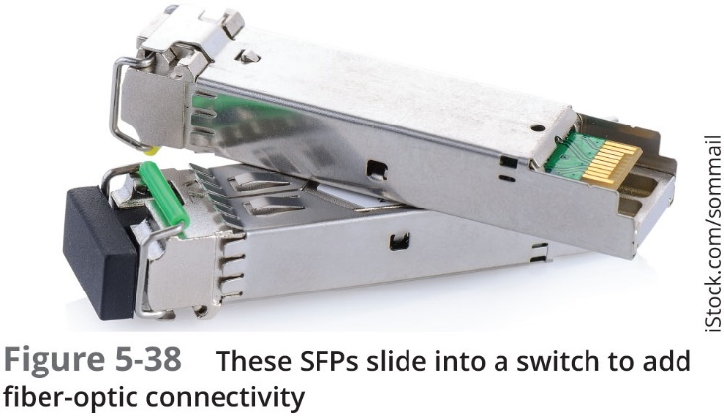
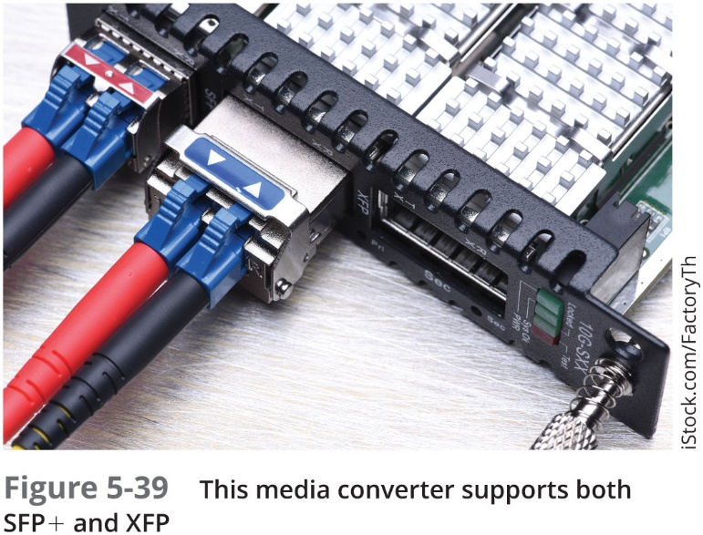
Fiber Transceivers (3 of 4)

Slide 48
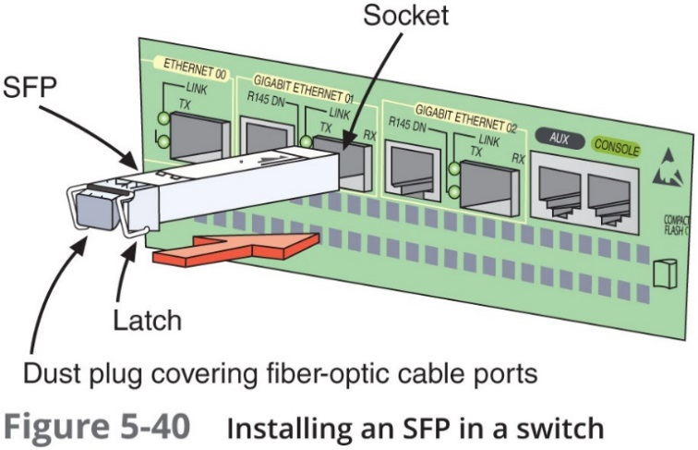
Fiber Transceivers (4 of 4)
BiDi transceivers:
Allows bidirectional transmission on both ports
Means fiber cable carries data in both directions
Installing a transceiver:
Slide the transceiver into a socket on the back of the connectivity device
Most S F Ps come with a tab or latch system and keyed so that they will slide into the socket when aligned properly

Slide 49
Ethernet Standards for Fiber-Optic Cable (1 of 2)
Table 5-6 Ethernet standards using fiber-optic cable
Standard | blank | Maximum transmission speed (Mbps) | Maximum distance per segment (m) | Physical media
Gigabit Ethernet | 1000Base-LX | 1000 | 550 for M M F, 5000 for S M F | M M F or S M F
blank | 1000Base-SX | 1000 | Up to 550, depending on modal bandwidth and fiber core diameter | M M F
10-Gigabit Ethernet | 10GBase-SR and 10GBase-LW | 10,000 | Up to 300, depending on modal bandwidth and fiber core diameter | M M F
blank | 10GBase-LR and 10GBase-LW | 10,000 | 10,000 | S M F
blank | 10GBase-ER and 10GBase-EW | 10,000 | 40,000 | S M F

Slide 50
Ethernet Standards for Fiber-Optic Cable (2 of 2)
Table 5-7 1000Base-SX Segment lengths
Multimode fiber diameter | Maximum segment length
50 microns | 550 m
62.5 microns | 275 m

Slide 51
Common Fiber Cable Problems
Fiber type mismatch:
More of a fiber core mismatch
Even same-mode cables can be mismatched if the cores have different widths
Wavelength mismatch
S M F, M M F, and P O F (Plastic Optical Fiber) use different wavelengths
Dirty connectors
Signal loss and other errors can start to cause problems

Slide 52
Troubleshooting Tools
Start troubleshooting a network connection problem by checking the network connection L E D status indicator lights:
Steady light indicates connectivity
Blinking light indicates activity
Red or amber light might indicate a problem
If a cabling issue is suspected
Know which tools are designed to analyze and isolate problems

Slide 53
Toner and Probe Kit (1 of 3)
Tone generator (toner):
Small electronic device
Issues signal on wire pair
Tone locator (probe)
Emits tone when electrical activity detected
Probe kit or toner probe
Generator and locator combination
Testing requires trial and error
Used to determine where wired pair terminates
Not used to determine cable characteristics

Slide 54
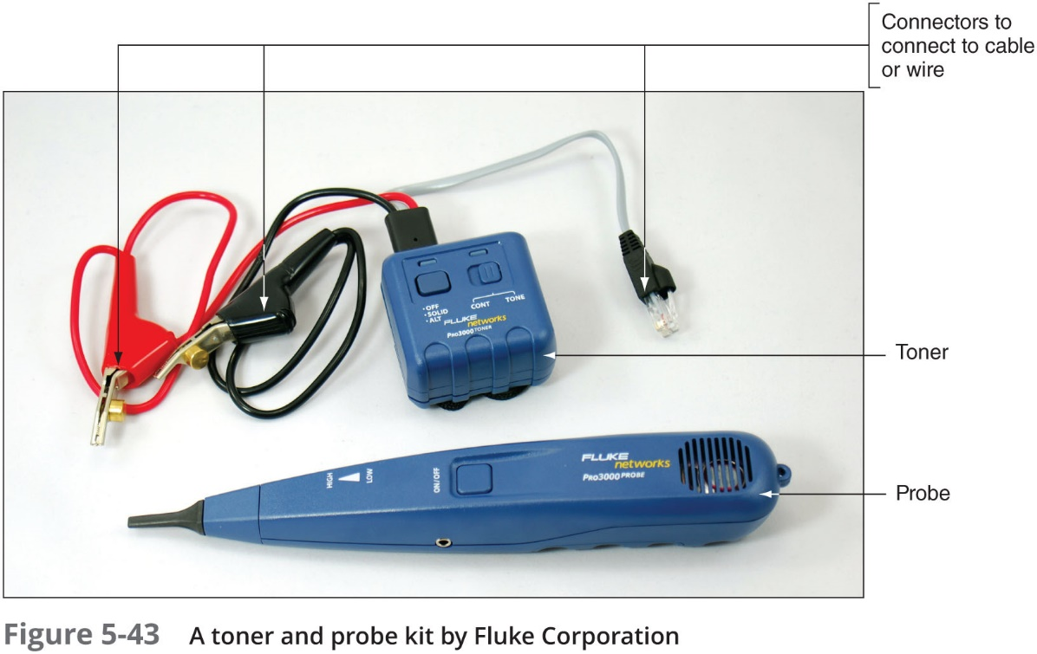
Toner and Probe Kit (2 of 3)

Slide 55
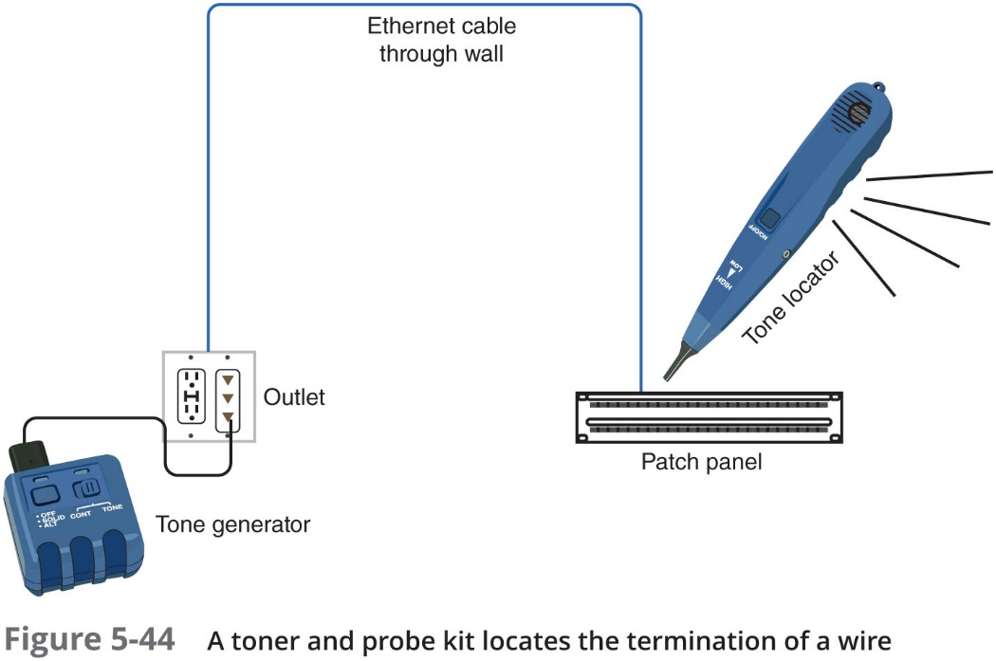
Toner and Probe Kit (3 of 3)

Slide 56
Multimeter (1 of 2)
Multimeter
Measures electric circuit characteristics
Resistance, voltage, and impedance
Use a multimeter to do the following:
Measure voltage to verify cable is conducting electricity
Check for the presence of noise
Test for short or open circuits in the wire:
Short circuit is an unwanted connection
Open circuit is one where needed connections are missing

Slide 57
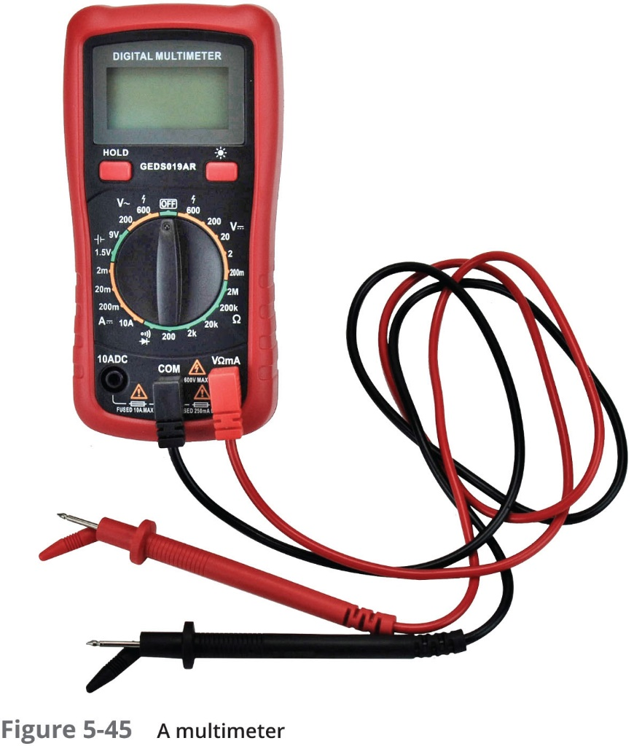
Multimeter (2 of 2)

Slide 58
Cable Continuity Tester (1 of 3)
Cable continuity testers (cable testers)
Tests whether cable carries signal to destination
Copper-based cable tester
Consists of two parts:
Base unit generates voltage
Remote unit detects voltage
Series of lights, audible tone
Used to signal pass/fail

Slide 59
Cable Continuity Tester (2 of 3)
Some continuity testers verify U T P, S T P wires paired correctly
Not shorted, exposed, crossed
Fiber optic continuity tester:
Issues light pulses on fiber
Determines whether pulses reach other end
Offer convenience: Portable, lightweight, and low cost

Slide 60
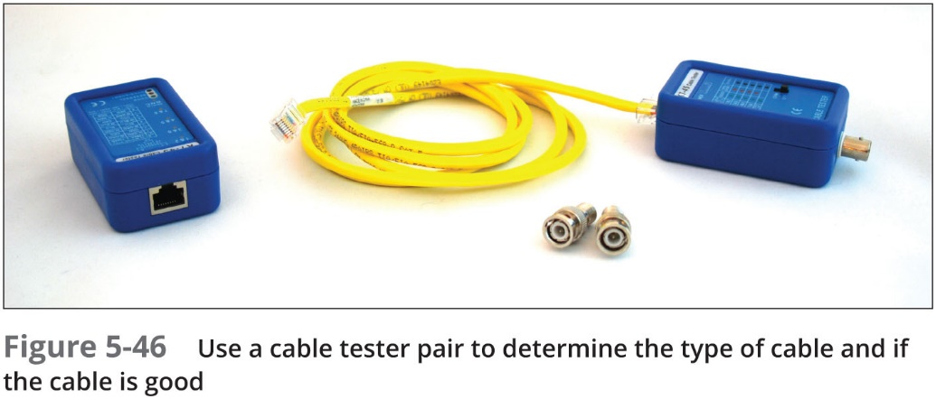
Cable Continuity Tester (3 of 3)

Slide 61
Cable Performance Tester (1 of 2)
Cable performance tester, line tester, or certifier
Performs similarly to continuity testers but can be used to:
Measure distance to a connectivity device, termination point, or cable fault
Measure attenuation
Measure N E X T (near end cross-talk)
Measure termination resistance and impedance
Issue pass/fail ratings for Cat 3–7 standards
Store and print results or save to a computer database
Graphically depict attenuation and cross-talk

Slide 62
Cable Performance Tester (2 of 2)
T D R (time domain reflectometer):
Issue signal, measures signal bounce back
Indicates distance between nodes
Indicates whether terminators properly installed, functional
O T D Rs (optical time domain reflectometers):
Measure fiber length
Determine faulty splice locations, breaks, connectors, bends, and measure attenuation over cable
Measure attenuation over the cable
Can be expensive

Slide 63
O P M (Optical Power Meter) (1 of 2)
O P M (optical power meter):
Also called a light meter
Measures the amount of light power transmitted on a fiber-optic line
Must be calibrated precisely, following highly accurate optical power standards
Surrounding room temperature, connection type, and the skill of the technician all affect the final test results

Slide 64
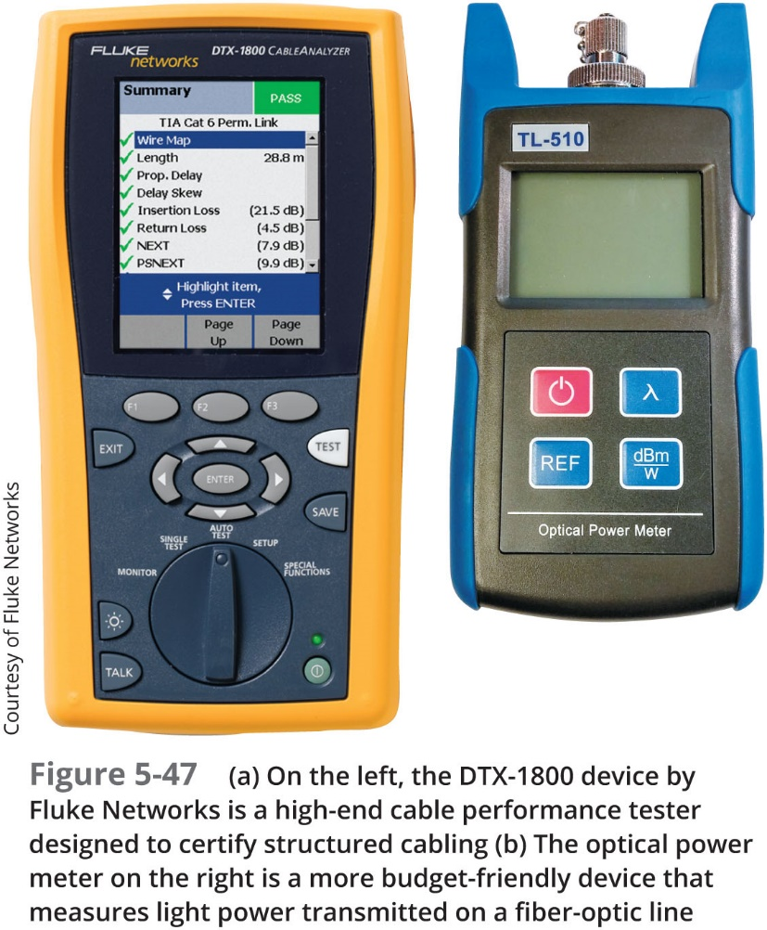
O P M (Optical Power Meter) (2 of 2)

Slide 65
Chapter Summary (1 of 4)
Bandwidth is the amount of data that could theoretically be transmitted during a given period of time
Noise can degrade or distort a signal
Duplex signals are free to travel in both directions over a medium simultaneously
Today’s networks might use RG-59 coaxial cable for short connections
Twisted-pair cable consists of color-coded pairs of insulated copper wires that are twisted in pairs:
S T P cable’s shielding acts as a barrier to external electromagnetic forces
U T P cable is both less expensive and less resistant to noise than S T P
S T P and U T P both use RJ-45 modular connectors and data jacks

Slide 66
Chapter Summary (2 of 4)
A crossover cable has the transmit and receive wires reversed
A router’s console port is used with a console cable, or rollover cable
A crimper pushes on the pins inside an RJ-45 connector so they pierce the wire’s insulation
Data is transmitted through the central fibers of fiber-optic cable via pulsing light sent from a laser or an L E D source
Laser-generated light travels over a single path in S M F cables
M M F contains a core with a larger diameter than S M F over which many pulses of light generated by a laser or L E D light source travel at different angles
Older fiber networks might use ST or SC connectors

Slide 67
Chapter Summary (3 of 4)
A media converter is hardware that enables networks or segments running on different media to interconnect and exchange signals
Cabling problems unique to fiber include fiber type mismatch, wavelength mismatch, and dirty connectors
Start troubleshooting a network connection problem by checking the network connection L E D status indicator lights
A tone generator issues a signal on a wire that can be detected by a tone locator
A multimeter can measure many characteristics of an electric circuit, including its resistance, voltage, and impedance

Slide 68
Chapter Summary (4 of 4)
A cable continuity tester is battery operated and has two parts: The base unit that connects to one end of the cable and generates a voltage, and the remote unit that connects to the other end of the cable and detects the voltage
A sophisticated cable performance tester will include T D R (time domain reflector) that issues a signal on a cable and then measures the way the signal bounces back
Detecting the type and locations of cable defects
An O P M (optical power meter) measures the amount of light power transmitted on a fiber-optic line

